Slide 1
INTERVIEWS
By Pamela Niyongere

Slide 2
Outline
Icebreaker (15min)
Interviews presentation (40 min)
Individual search (20 min)

Slide 3
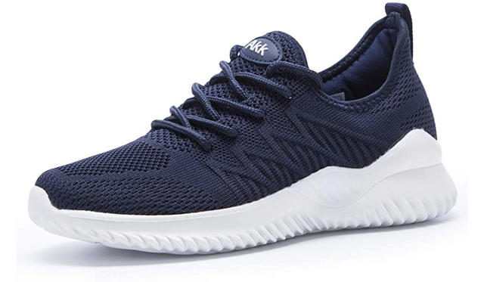
Icebreaker

Slide 4
Check-in
What has been one highlight and one lowlight of this opportunity program so far?

Slide 5
Interviews
Think-Pair- Share: What do you know so far about interviews?

Slide 6
Step-to-step guide
Carefully examine the job description/the opportunity
Source: https://www.indeed.com/career-advice/interviewing/how-to-prepare-for-an-interview
Notes:
During your prep work, you should use the employer’s posted job description as a guide. The job description is a list of the qualifications, qualities and background the employer is looking for in an ideal candidate. The more you can align yourself with these details, the more the employer will be able to see that you are qualified. The job description may also give you ideas about questions the employer may ask throughout the interview.

Slide 7
Step-to-step guide
2. Consider why you are interviewing and your qualifications
Source: https://www.indeed.com/career-advice/interviewing/how-to-prepare-for-an-interview
Notes:
Before your interview, you should have a good understanding of why you want the job and why you’re qualified. You should be prepared to explain your interest in the opportunity and why you’re the best person for the role.

Slide 8
Step-to-step guide
3. Perform research on the company/institution and role
Source: https://www.indeed.com/career-advice/interviewing/how-to-prepare-for-an-interview

Slide 9
Step-to-step guide
4. Consider your answers to common interview questions
Source: https://www.indeed.com/career-advice/interviewing/how-to-prepare-for-an-interview

Slide 10
Step-to-step guide
5. Practice your speaking voice and body language
Source: https://www.indeed.com/career-advice/interviewing/how-to-prepare-for-an-interview

Slide 11
Step-to-step guide
6. Prepare thoughtful questions for the interviewer
Source: https://www.indeed.com/career-advice/interviewing/how-to-prepare-for-an-interview

Slide 12
Step-to-step guide
7. Conduct mock interviews
Source: https://www.indeed.com/career-advice/interviewing/how-to-prepare-for-an-interview

Slide 13
Step-to-step guide
8. Dress to impress
Source: https://www.indeed.com/career-advice/interviewing/how-to-prepare-for-an-interview

Slide 14
Step-to-step guide
9. Be on time!!! ( at least 15 mins before the interview)
Source: https://www.indeed.com/career-advice/interviewing/how-to-prepare-for-an-interview

Slide 15
Step-to-step guide
10. Sell yourself
Source: https://www.indeed.com/career-advice/interviewing/how-to-prepare-for-an-interview

Slide 16
Step-to-step guide
11. Get ready to follow up after the interview
Source: https://www.indeed.com/career-advice/interviewing/how-to-prepare-for-an-interview

Slide 17
Task
Take the rest of the session to research the most common interview questions. (Be ready to share in the next session!)
Source: https://www.indeed.com/career-advice/interviewing/how-to-prepare-for-an-interview

Slide 18
Thank you!

