Slide 1
Menya Opportunities Program
By
Pamela Niyongere

Slide 2
Welcome and Introduction

Slide 3
Introduction
Name
School
One interesting fact about you
Notes:
10 min

Slide 4
Welcome Remarks
By
Don de Dieu

Slide 5
Menya Accelerator
Menya Accelerator is a not-for-profit education-centered social initiative that aims at providing high-quality education programs for youth enrolled in formal education institutions and beyond in Burundi.
This initiative fosters the development of creative thinking, and the acquisition of 21st-century skills, while promoting community-building and entrepreneurship. At Menya Accelerator, we believe in the power of technology, innovation, and human-centered interventions in both our lesson delivery and practical experiences.
We believe that young Burundians equipped with the right skills relevant to their local context and connected to opportunities can be the catalyzers for Burundi’s socio-economic development through community-based entrepreneurship and more.
Notes:
Team introduction: 10 min

Slide 6
Mission
Our mission is to equip the Burundian youth with capacities and skills by leveraging entrepreneurship and technology to advance education, leadership, and practical learning experiences for youth in Burundi. We equip young people with 21st century skills, knowledge, and opportunities to better their lives and reach their full potential.
Our Learning Methodology
We supplement Burundi’s education system by leveraging technology to deliver leadership, entrepreneurship an English curriculum, and access to a range of academic and professional development opportunities.
Notes:
Team introduction: 10 min

Slide 7
Our values
Notes:
Team introduction: 10 min

Slide 8
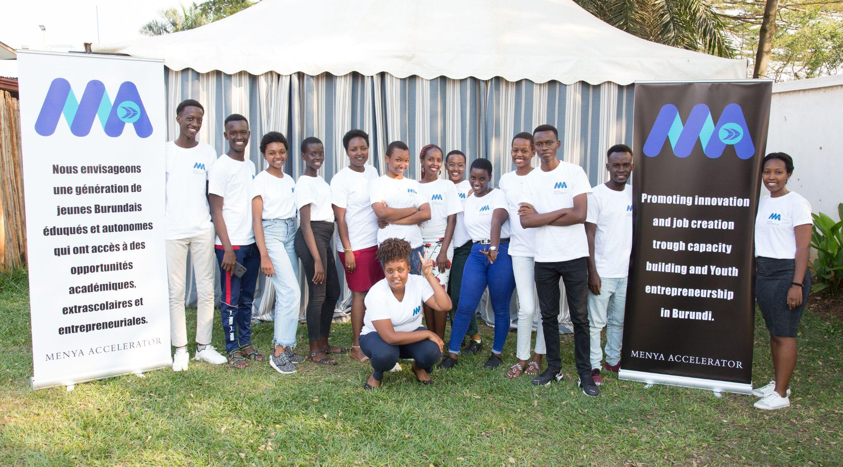
Menya Cohort 1
Notes:
Team introduction: 10 min

Slide 9
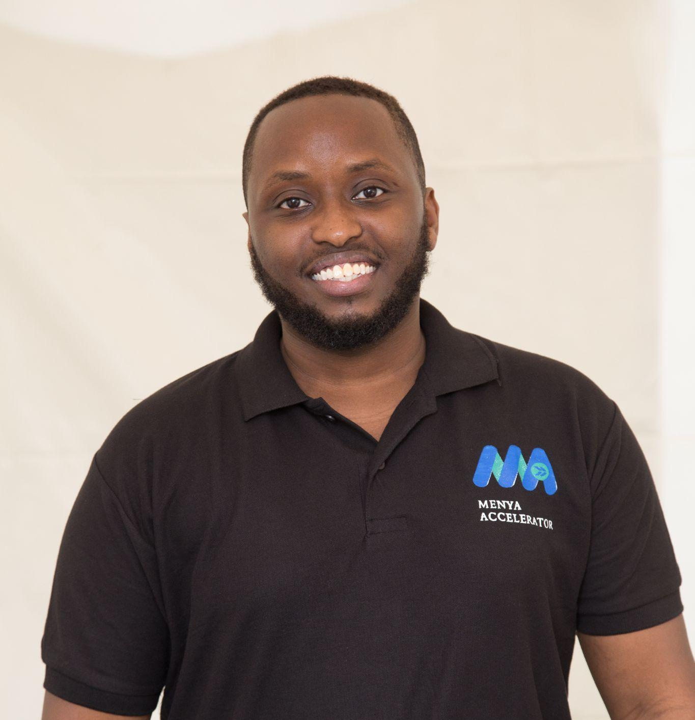
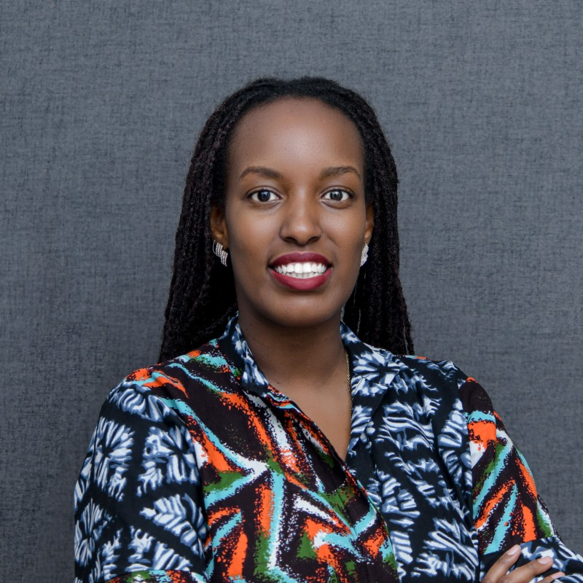
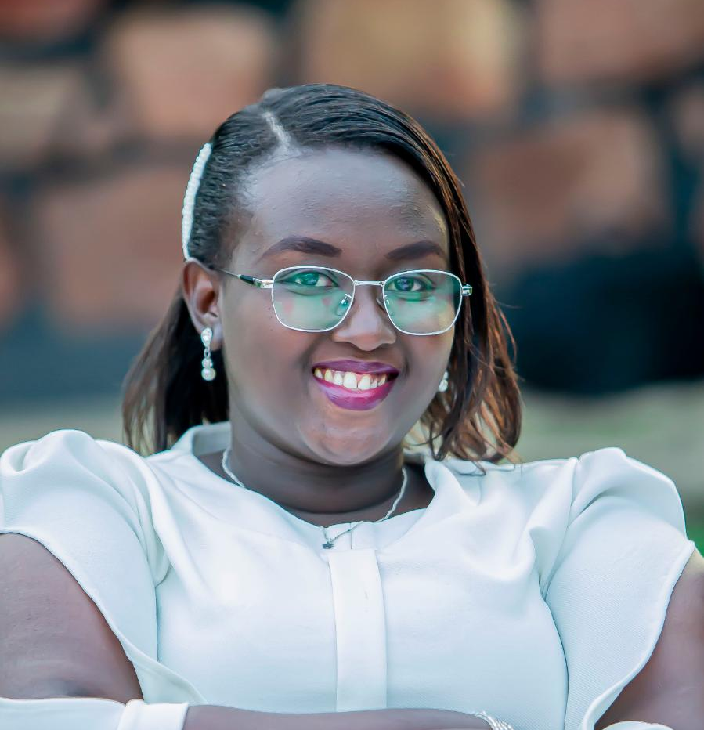
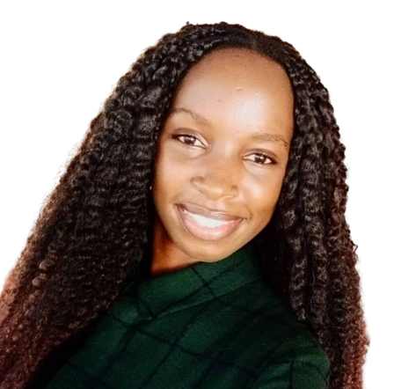
Our Team
Don de Dieu
Nicole
Jade
Heritier
Pamela
Founder & CEO
Opportunities Program Manager
Operations Program Manager
Monitoring and Evaluation Program Manager
Entrepreneurship Program Manager
Notes:
Team introduction: 10 min

Slide 10
Scavenger Hunt

Slide 11
2023 Opportunities Program: Broadening your horizon as a Burundian student

Slide 12
Objectives
This course was designed to allow Burundian students in high schools and universities to learn important skills to access diverse educational opportunities. By the end of this program, you will be able to:
1. Navigate any application process.
2. Write competitive essays.
3. Express yourself in front of others and in an interview.
4. Confidently compete in global opportunities.
5. Have access to a variety of opportunities on our platform.
6. Have access to some mentorship programs.
Notes:
Team introduction: 10 min

Slide 13
Module 1: Building your profile
Notes:
30 min

Slide 14
Module 2: Opportunities search
Notes:
30 min

Slide 15
Module 3: Essay Writing
Notes:
30 min

Slide 16
Module 4: School interviews
Notes:
30 min

Slide 17
Module 5: Guide to Standardized Tests

Slide 18
Additional items to be covered throughout
Public Speaking
Critical Thinking/Problem Solving
Networking & Mentorship

Slide 19
What else would you like to experience in this program?
(Write on a piece of paper)
Notes:
Google form: expectations, familiarity, etc,

Slide 20
Charades Game

Slide 21
Program Structure
Timelines | Modules | Type
August 14 - September 1st | Module 1 Module 2 Module 3 (Part 1) | In person sessions
Week of September 4: School starts- No sessions
September 11-October 29th | Module 3 (Part 2) Module 4 Module 5 | Hybrid sessions (Online sessions + In person for those who can)
Tuesday, October 31st: End of the program + Certificates
November onwards: After program activities: Applying to opportunities, English conversations, etc.
Notes:
Team introduction: 10 min

Slide 22
Program Policies
Full commitment up until the end of the program and committed to after program activities.
Attend all sessions in person up until September 1st.
Attend all hybrid sessions and submit all assigned work.
Pay attention to reading assignments!
Ask for help!
Teamwork before anything else! (Does not mean plagiarizing!)
Submit a journal in English (Max. 1 page) every Friday!

Slide 23
First Assignment
Reading: Managing Oneself by Peter F. Drucker

Slide 24
Team Building Activity

Slide 25
Thank you!
Any questions?

